Slide 1

Ham 420
Mo-Kan Regional Council of
Amateur Radio Organizations, Inc.
Copyright © 20123–2024 All Rights Reserved
Overview of Amateur Radio, Radio Propagation,
and How It Applies in the Context of the
Search for Amelia Earhart, July 1937
By: WØICQ – Randal R. Schulze and KAØSOG – David Hinkley
Version 1.01 09AUG2024

Slide 2
Ham 420-Overview of Amateur Radio and Radio Propagation
Welcome to Ham 420, Overview of Amateur Radio, Radio Propagation, and How It Applies in the Context to the Search for Amelia Earhart during July 1937
This presentation is developed at the request of the Amelia Earhart Hanger Museum of Atchison, Kansas in response to frequent questions the museum has received regarding the role of Amateur Radio and Radio in general during the Search for Amelia Earhart during July 1937.
While trying not to be too technical, we will attempt to provide an overview of radio as it was then and now, radio propagation, concepts of radio communications and their impact on the search.
We’re Glad You’re Here!

Slide 3
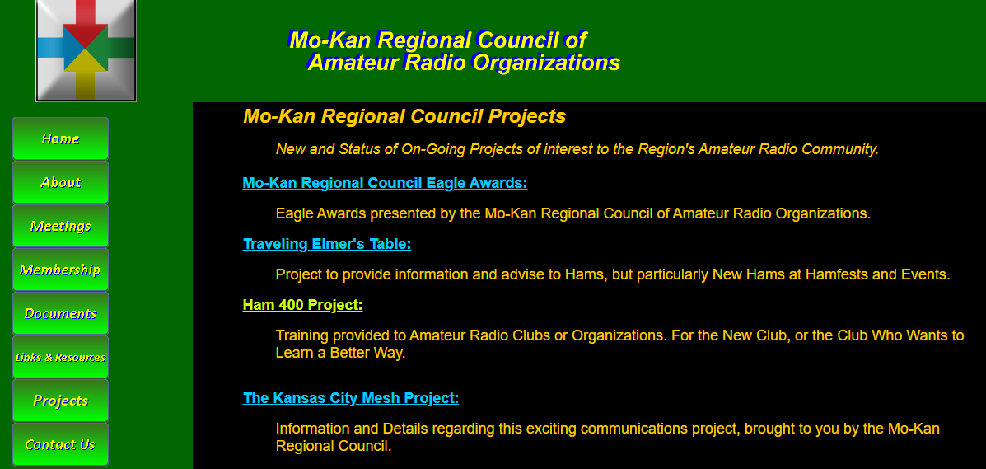
Ham 420-Overview of Amateur Radio and Radio Propagation
A copy of this Powerpoint Presentation can be downloaded from:
https://mokancouncil.org/Ham400Project.htm
Or go to https://mokancouncil.org, look for “Projects” on the left side, then select “Ham 400 Project.” Now look for “Ham 420.”

Slide 4
Ham 420-Overview of Amateur Radio and Radio Propagation
About This Presentation:
The disappearance of Amelia Earhart has been a mystery for the better part of a century. Part of the research which has been conducted has centered on the role played by the use of radio, and whether or not any of the transmissions heard during that time were actual distress calls made by Amelia Earhart herself.
There is a significant amount of information which can be found online on this topic. It is not the intent of this presentation to repeat what has already been written. It is our intent to provide an overview of radio, radio propagation, and technology so that a person looking at the evidence might have a better understanding of how possibly Earhart and or Noonan might have been heard.

Slide 5
Ham 420-Overview of Amateur Radio and Radio Propagation
About This Presentation:
The Question:
  Is it possible for radio messages to have been received from Amelia Earhart after her disappearance?
Assumptions:
  While there have been many theories as to what happened to Amelia Earhart and John Noonan, at the time of the writing of this presentation, no one really knows what happened to these aviators. The possibility of any radio transmissions being made by Amelia Earhart is based on the assumption that she survived any crash or crash landing of her aircraft and that the radio equipment also survived.

Slide 6
Who is the Mo-Kan Regional Council?
The Mo-Kan Regional Council is a “Club of Clubs or Organizations” which have a unique interest in Amateur Radio. Our Bylaws define our mission as:
  -Coordinate and foster activities, efforts, and points of the view of the various amateur radio clubs and organizations from the region.
  -Coordinate and provide meaningful recognition of individuals from the region who have made notable contributions to amateur radio.
  -Serve as the combined voice for amateur radio on issues affecting amateur radio within our region.
  -Create solidarity of purpose, a united voice, and a source of pride in everything that is the amateur radio community of our region.
    Mo Kan Regional Council of
    Amateur Radio Organizations, Inc.

Slide 7
What is Amateur Radio?

Slide 8
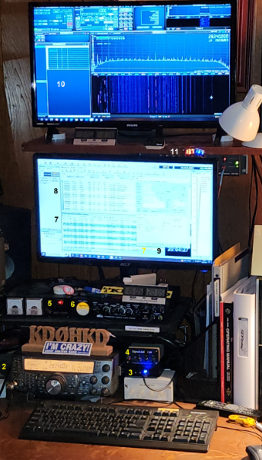
What is Amateur Radio?
Amateur Radio, also known as Ham Radio, is a hobby. Ham radio operates within the use of the radio frequency spectrum for purposes of non-commercial exchange of messages, wireless experimentation, self-training, private recreation, radiosport, contesting, and emergency communications.
The term "amateur" is used to specify "a duly authorized person interested in radioelectric practice with a purely personal aim and without pecuniary interest"; (either direct monetary or other similar reward). This was to differentiate it from commercial broadcasting, public safety (such as police and fire), or professional two-way radio services (such as maritime, aviation, taxis, etc.).
In other words a ham cannot use their radio to make money.

Slide 9
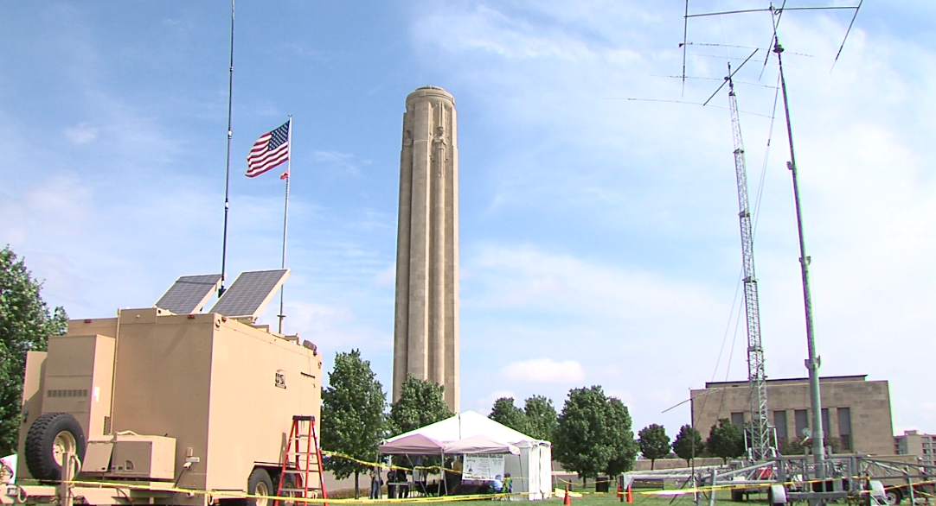
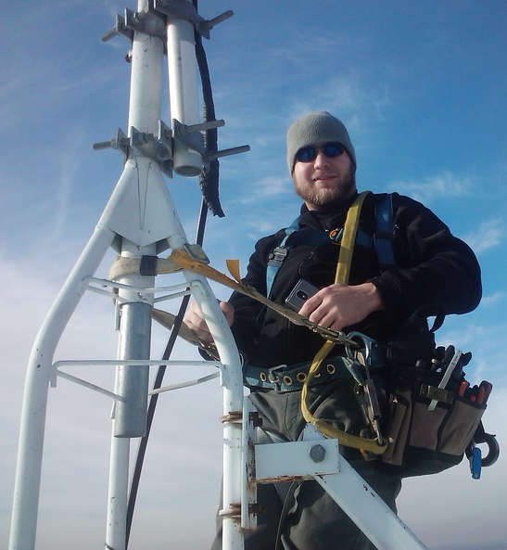
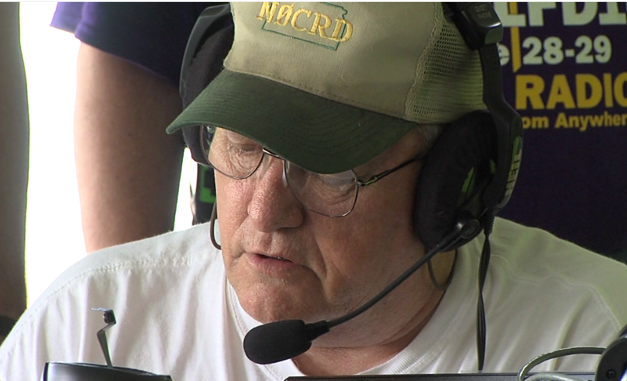
What is Amateur Radio?
Ham Radio includes a diverse array of radio modes and technologies across various different bands within the radio spectrum.
In Broad Terms, Modes include: CW (Morse Code) Phone (Voice) Satellite Packet (Teletype) Digital (Computer) Mesh (Wireless Internet) | In Broad Terms, Bands Include: VLF – Very Low Frequency (Long Wave) LF – Low Frequency (Medium Wave) HF – High Frequency (Short Wave) VHF – Very High Frequency UHF – Ultra High Frequency SHF – Super High Frequency (Micro Wave)

Slide 10
How do radios work?
The Basic Concepts

Slide 11

Radio Waves
Throw a rock in a pond. The rock lands on the water’s surface and pushes the water out of the way. The energy that creates this effect is from the force of gravity pulling it down and transfers it to the water’s movement. That movement creates the ripples in the pond

Slide 12
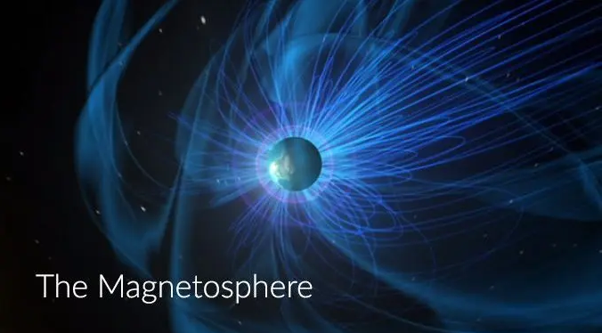
Radio Waves
Radio has a similar impact on the magnetosphere that surrounds our planet. The transmitter is the rock in the pond. The radio waves are the ripples. Do you want the radio waves to get all the way across the pond? Get a bigger rock or drop it from a higher distance. In other words a more powerful transmitter or change the height (wavelength) you are transmitting on.

Slide 13
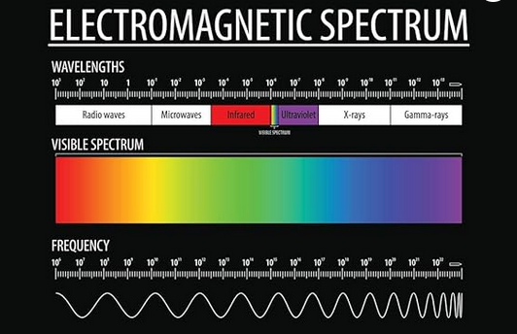
Radio Waves
Radios can transmit and decode (receive) radio energy waves from the magnetosphere.
Energy waves can come in different kinds of waves; radio waves, sound waves, light waves and xrays. Radio waves can work within the radio wave spectrum. The sound you detect is imbedded in the radio wave and the radio can reproduce it.

Slide 14
Energy Waves
Hams sometimes brag about their stations being capable of ‘DC to Daylight’.
They are talking up that they can work the entire radio spectrum. The lowest energy in the radio spectrum in frequency is above electrical DC and below the speed of light.
  DC – No wave energy
  Sound – Humans can hear from 20 to 20,000 Hz
  (Hz = Cycles per second.)
  Radio waves – The radio spectrum runs from 30,000 HZ to 3,000 Ghz

Slide 15
Dividing up the Radio Spectrum
Managing the Chaos

Slide 16
Dividing up the Radio Spectrum
Remember the earlier slides talking about the different radio services (hams, public service, broadcasters?) That’s done by the FCC to prevent chaos on the air.
Can you imagine a ham keying his mic to talk on the same frequency as the heart monitors in the local hospital? A ham might listen in anywhere on the radio spectrum; but by law, he or she has to limit any transmission to the ham radio permitted bands. It’s 10 years in Federal Prison and or $10,000 per occurrence.
Randy and David believe Leavenworth is a nice place to visit but we don’t want to live there.

Slide 17
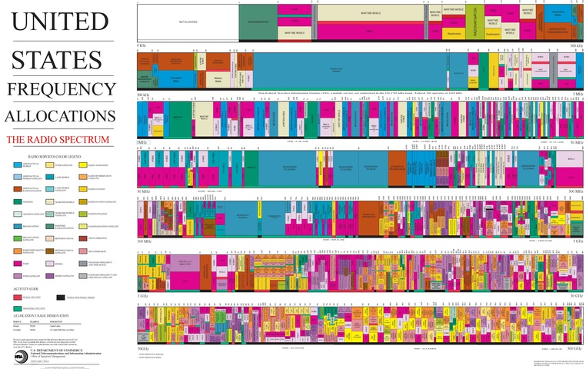
Dividing up the Radio Spectrum
Understanding the allocation of frequencies will become very important to our look at the search for Earhart and Noonan. More on that later

Slide 18
HF Radio Propagation
Short and Long Distance Radio

Slide 19

HF Radio Propagation
Some Other Terms to be discussed
At a high level, we will describe these various terms and concepts:
  Propagation
  Frequency and Wave Length
  Groundwave
  Ionosphere
  Sky-Wave
  Harmonics

Slide 20
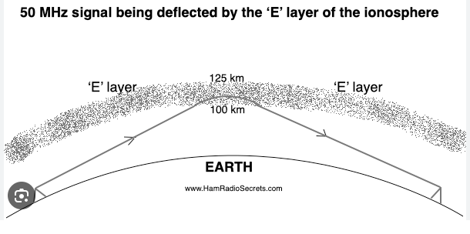
HF Radio Propagation
Groundwave and Skywave:
Groundwave is The method by which radio waves travel along the Earth’s surface.
Skywave is The method by which radio waves travel through the ionosphere and back to Earth. Sometimes called skip, sky-wave propagation has a far greater range than line-of-sight or ground-wave propagation

Slide 21
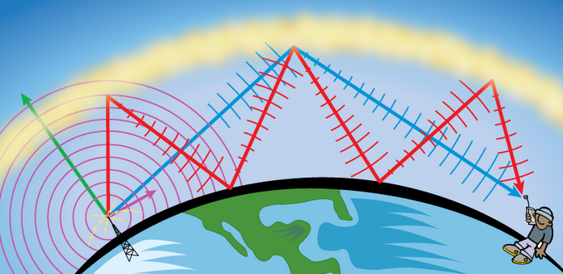
HF Radio Propagation
Ionosphere:
A region of electrically charged (ionized) gases high in the atmosphere. The ionosphere bends radio waves as they travel through it, returning them to Earth. (Radio waves loose a little bit of their strength with each bounce off the ionosphere and the earth.) In other words, the Ionosphere is the top of the pond ripple.

Slide 22
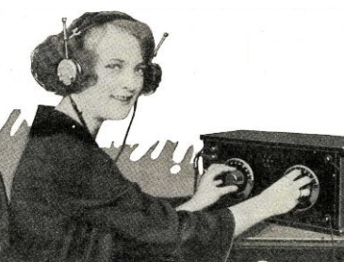

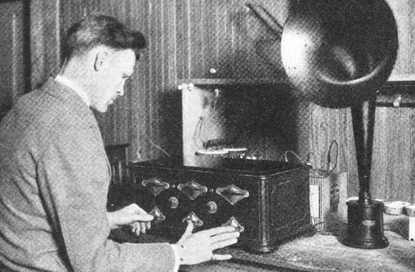
HF Radio Propagation
We can manipulate these hops by changing the frequency we transmit on (the number of hops over a given distance). We can also manipulate by producing them with more power (the more energy it can loose per bounce without it being used up.)
To give you a better idea of why the government requires a ham to pass a technical exam to become licensed …
Remember the CB craze? CB radios were limited to a transmit power of 4 ½ watts on a small number of channelized frequencies. Hams are licensed, generally speaking, to 1500 watts (1.5 kw) and in 18 bands of frequencies. Now you understand why the fines and potential for a vacation at Leavenworth.

Slide 23
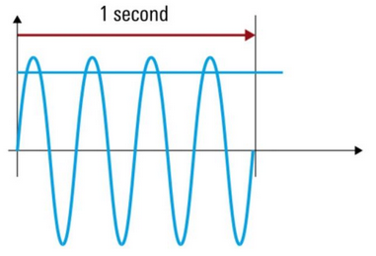
HF Radio Propagation
Frequency:
Frequency is a measurement of how far a wave travels in a specific time period. Frequency is typically measured in Cycles or Hertz per Second.
  The graphic at right depicts 4 Cycles per Second.
In terms of radio communications, a frequency would typically be referred to in Kilohertz, (KHz) for thousands of Cycles per Second, or Megahertz (MHz) for Millions of Cycles per Second.

Slide 24
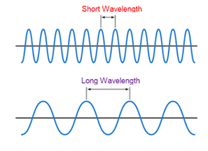
HF Radio Propagation
Wavelength:
When a radio band such as the 10 meter band is referred to, they are referring to the average wavelength.
Wavelength=300/ Frequency in MHZ. Example American FM broadcast runs from 87 Mhz to 108Mhz. Let’s say the average Frequency is 100 Mhz. That makes it the 3 meter band.
Don’t dwell on this too long, as it can be confusing to many. It is relevant to our discussion as it relates to the length of an antenna used on a given frequency, band, etc. Hams will use both terms interchangeably.

Slide 25
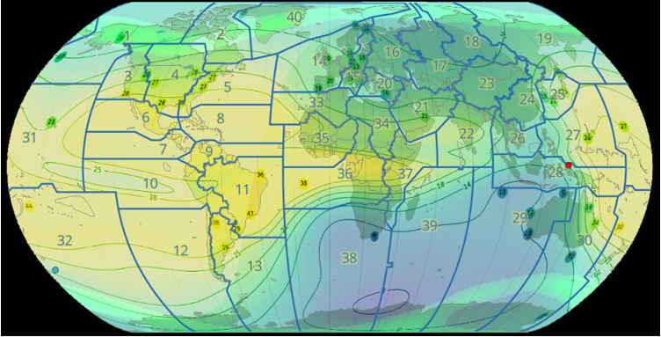
HF Radio Propagation
Radio Propagation:
The process by which radio waves travel. Variables which may affect propagation include:
  Time of Day / Night
    Remember as a kid listening to WLS or Radio Del Rio?
  Time of Year
  Solar Activity
    Number of Sun Spots (More is Good)
      1937 was the PEAK of Solar Cycle 17
    Solar Flairs / Geomagnetic Storms (Bad)
  Transmitter Power
  Antenna Configuration
  Dumb Luck

Slide 26
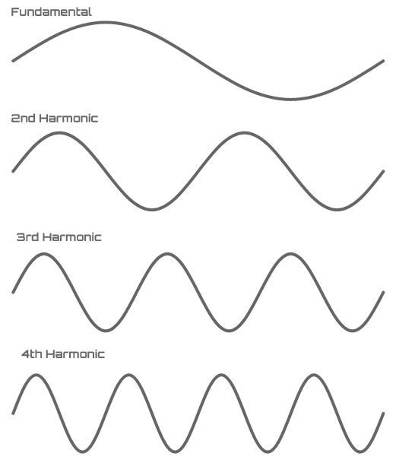
HF Radio Propagation
Harmonics:
Harmonics are integer multiples of the fundamental frequency. For example, if the fundamental frequency is 50 Hz (also known as the first harmonic) then the second harmonic will be 100 Hz (50 * 2 = 100 Hz), the third harmonic will be 150 Hz (50 * 3 = 150 Hz), and so on.
A picture is worth a thousand words. Let’s take a look at the next slide to get a better visual on how this is relevant in radio.

Slide 27
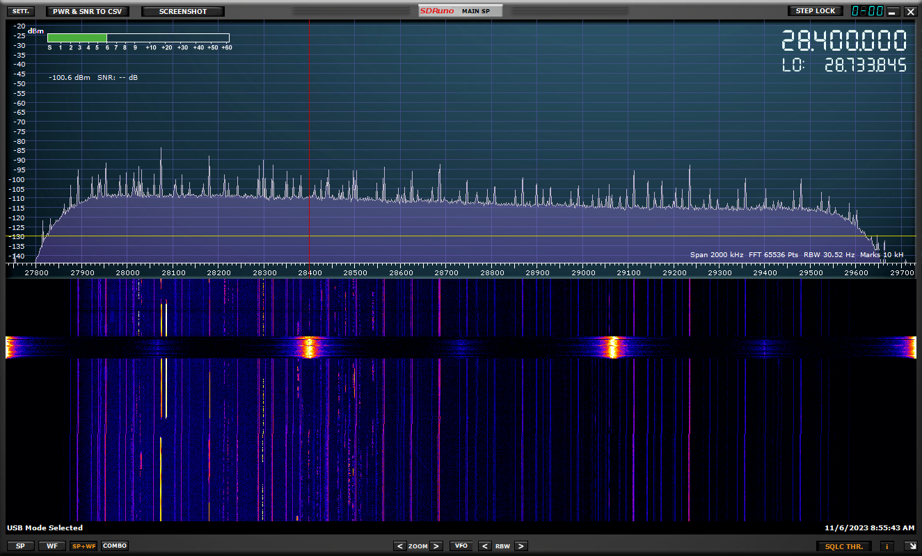
HF Radio Propagation

Slide 28
HF Radio Propagation
Frequency:
In 1937, it was rare for radio frequencies to be referred to in the millions of cycles per second, thus most of the documentation of the time is referred to as “Kilo” Cycles.
Additionally, in 1960, the term for Cycles was officially changed to Hertz in honor of Physicist, Henrich Hertz. Thus, documentation from the time of 1937 will use the term, Kilocycles per Second, KCPS, or the abbreviation, KCs.

Slide 29
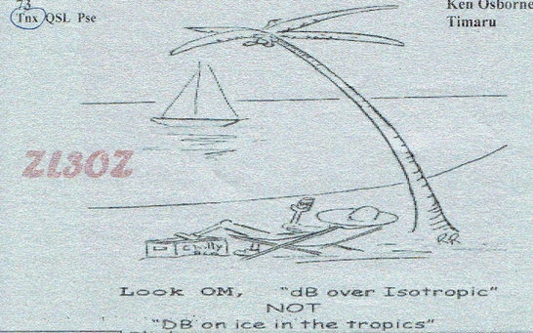
HF Radio Propagation
Dumb Luck:
Late in the evening during June 2012, I was spinning the dial, and not finding much on the air. All forecasting tools indicated that DX was not likely. The noise level was very low and there was hardly any activity.
On 15 meters, I heard a faint voice calling CQ to which I replied. There was a pause when the voice came back saying, “Wow! I turned on the radio to call for a few of my local mates, and I found a Yank! How’s it going?” The station was Ken Osborn – ZL3OZ in New Zealand! We were both surprised!
From a technical perspective, this communication should not have been possible, but yet it did!

Slide 30
Applying the Technical Concepts
Now that we have a grasp on the concepts, let’s apply that to the known facts.

Slide 31
Applying the Technical Concepts
“Earhart’s Western Electric model 13C transmitter had no harmonic suppression circuitry, and thus generated and delivered power to the plane’s dorsal antenna at harmonics of the fundamental frequency – 3105 kHz or 6210 kHz. The antenna’s radiation efficiency at harmonic frequencies enabled signal reception at distances of thousands of miles under suitable propagation conditions. Therefore, reports of Earhart signals heard on harmonic frequencies cannot be dismissed on the basis of frequency alone.”
  From Research Paper: Catalog and Analysis of Radio Signals During The Search for Amelia Earhart in July 1937.
  By: Bob Brandenburg and Ric Gillespi. Copyright © 2021 TIGHAR, Used by Permission
Reportedly, the antenna on Earhart’s airplane was 46 Feet and 54 Feet. After making conversions from Meters to Feet, the optimum length should have been 39 Feet 6 Inches. I have read articles of opposing opinions; one side saying this antenna would not work, other saying that this antenna would have been efficient enough at the frequencies being used at 3105 KHz and 6210 KHz.
There was another transmit frequency of 500 khz that was available. This frequency used morse code exclusively. Neither Earhart nor Noonan were trained in Morse Code.

Slide 32
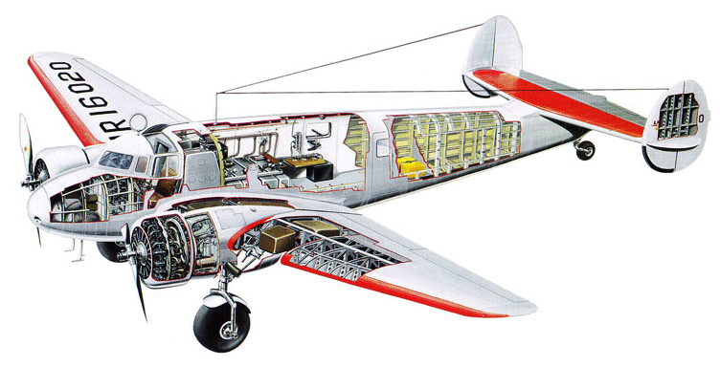
Applying the Technical Concepts

Slide 33
Applying the Technical Concepts
Propagation:
Under favorable propagation conditions, it was possible for aircraft operating on the U.S. west coast at night to be heard on 3105 kHz in the central Pacific. The Itasca reported hearing such signals on one occasion.
  From Research Paper: Catalog and Analysis of Radio Signals During The Search for Amelia Earhart in July 1937.
  By: Bob Brandenburg and Ric Gillespi. Copyright © 2021 TIGHAR, Used by Permission
Additionally, radio propagation conditions were known to be good during this period. 1937 was the peak for Solar Cycle 17.
Harmonics:
In reading the analyses, many of the received signals deemed “credible” were
NOT received on 3105 and 6210 KHz, but were received on Harmonic Frequencies, some by professional operators, and other by common citizens using standard short wave broadcast receivers of the time.

Slide 34
Old Time Radio
Radio as it Was Known and Used in 1937

Slide 35
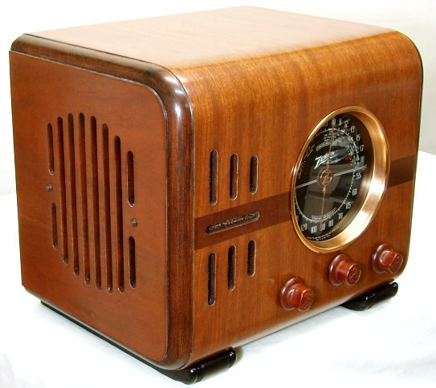
Old Time Radio
Timeline Leading Up to 1937:
  1886: Discovery of Radio Waves
    Physicist, Hinrich Hertz said radio had “no practical application.”
  1901: First Transatlantic Radio Message
    Marconi, using Mores Code.
  1906: First Voice Transmission
    Voice and Music
  1919: First Regular Radio Station (Holland)
  1920: First US Radio Station – KDKA
  1923: First Two-Way Radio Voice
    Some dispute over who and when…
  1925: First Transatlantic Broadcast

Slide 36
Applying the Technical Concepts
A note about standard broadcast receivers of the period around 1937:
  Depicted at right is a standard Zenith Model
  5-S-218, introduced in 1937. I own a restored radio of this model, as it was the same as what I fondly remember my Grandparents had in their home, while I was growing up. It has 3 bands. One standard US AM Broadcast, and Two AM Shortwave Broadcast Bands.
  The next slide depicts a dial face for a Zenith Radio from the period, showing the shortwave tuning positions on the dial. Common users who intercepted suspected Earhart signals were not looking for Earhart per se, they were simply tuning around for a favorite broadcast and stumbled across the signal.

Slide 37
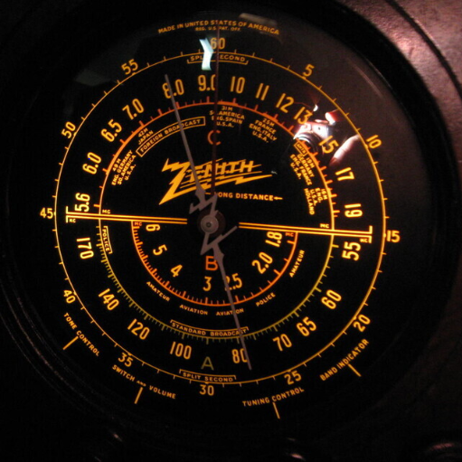
Applying the Technical Concepts

Slide 39
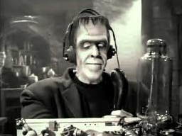
Old Time Radio
This is important:
  1912: While they knew radio existed above medium wave, that area of the spectrum was considered commercially useless. Amateur radio was relegated to the 200 Meter Band, and the limited range of 25 miles. This regulation continued until 1924 when Amateurs are granted access to 80, 40, 20, and 5 meters.

Slide 40
A Very Interesting Conclusion.

Slide 41

One Very Interesting Conclusion
Go Figure!
  Through all our research, we were surprised not by what we found, but by what we did not find…
  Amateur Radio Operators did not play a part, nor did we find any evidence that Amateur Radio Operators received or intercepted any suspected Earhart radio messages!
  All messages received were by professional, corporate, airline, shipping, military, or common folks with their home radios.

Slide 42
Could radio have rescued Amelia Earhart and Mr. Noonan?
In our opinion its very possible EXCEPT:
  Their equipment worked at 500khz, 3105khz & 6210khz.
  These are the amateur licensed frequencies in 1937. Do you see a problem?
    Earhart 500 khz
    MORSE CODE ONLY Ship to shore Emergency World Wide
    Earhart 3105 khz
    Amateur B Band 3500 khz to 4000 khz
    Earhart 6210 khz
    Amateur C Band 7000 khz to 7300 khz

Slide 43

Just Our Opinion…
Provided they survived the landing, it is possible that radio distress signals from Amelia Earhart were received?
It is possible that ordinary folk in the continental US may have received radio distress signals from Amelia Earhart on their home radio sets?

Slide 44
Just Our Opinion…
There is a Ton of information which can be found online regarding the topic of possible radio distress message which may have been sent by Amelia Earhart. I strongly urge you to read:
Catalog and Analysis of Radio Signals During The Search for Amelia Earhart in July 1937
This can be found at https://tighar.org
In this research paper they have done in depth, detailed analyses, including the evaluation of reported messages received.

Slide 45
Q & A
Do You Have Any Questions?

Slide 46
Thank You!
The Mo-Kan Regional Council of
Amateur Radio Organizations
Version 1.01 09AUG2024

